Slide 1


HTML 5
New APIs - Part 1

Slide 2

HTML5 - New APIs
Course objectives
By completing this course, you will be able to:
Develop multi-threaded JS applications
Use Drag & Drop features in your web apps
Geolocalize a user of your web apps
Do cross-document messaging

Slide 3


HTML5 - New APIs
Course topics
Course’s plan:
Web Workers
Drag & Drop
Geolocation

Slide 4

Web worker
HTML5 - New APIs

Slide 5
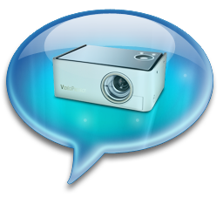
Web Worker
Presentation
Web Workers API allows you to run scripts in the background
Independently of any user interface scripts !
Useful for long-running scripts
Don’t need to manage yielding to keep the page responsive

Slide 6
Web Worker
Thread safety
Web Workers use real OS-level threads
As in other technologies, bad concurrency code can cause starvations, dead locks and other side effects

Slide 7
Web Worker
Thread safety
To limit these issues, the API provides :
A carefully controlled communication between threads
No access to non-thread safe components or the DOM

Slide 8
Web Worker
Worker interface
The core of the API is the Worker interface
It provides the following constructor :
Worker(scriptUrl) :
Creates a web worker that executes the script at the specified URL

Slide 9
Web Worker
Worker interface
It also provides the following methods :
postMessage(message) :
Sends a message to the worker's inner scope
terminate() :
Immediately terminates the worker without offers the worker an opportunity to finish its operations

Slide 10
Web Worker
Worker interface
And the following properties :
onmessage :
An event listener called when the worker return a message
onerror :
An event listener called when the worker return an error

Slide 11
Web Worker
Worker scope
Scripts executed by Workers have access to :
postMessage(message) function
Returns a message to the message handler of the main thread
onmessage property
Function which will receive messages sent when the worker object's postMessage() is called

Slide 12
Web Worker
Worker principle
Main thread
var worker = new Worker("worker.js");
worker.postMessage(message);
// Do something
worker.onmessage = function(event) {
// Do something
};
worker.js
...
onmessage = function(event) {
// Do something else
postMessage(message);
}

Slide 13
<ul id="result"></ul>
<script type="text/javascript">
var worker = new Worker('factorial.js');
worker.onmessage = function(event) {
var result = event.data;
var li = "<li>Factorial(" + result.n + "): ";
li += result.factorial + "</li>";
document.getElementById("result").innerHTML = li;
};
worker.postMessage(prompt("Number: "));
</script>
Example - index.html

Slide 14
function factorial(n, callback) {
if ((n == 0) || (n == 1)) callback(1);
else {
factorial(n - 1, function(result) {
postMessage({ n: (n - 1), factorial: result });
result *= n;
setTimeout(function() { callback(result) }, 2000);
});
}
}
self.onmessage = function(event) {
factorial(event.data, function(result) {
postMessage({ n: event.data, factorial: result });
});
}
Example - factoral.js

Slide 15
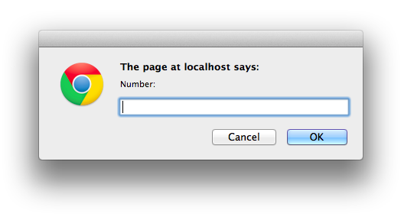
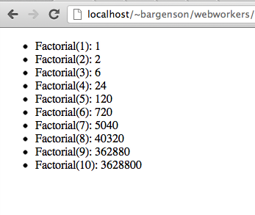
Web Worker
Example

Slide 16


Questions ?

Slide 17
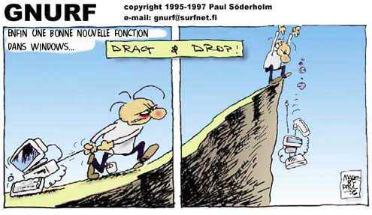
Drag & drop
HTML5 - New APIs

Slide 18
Drag & Drop
Presentation
Drag and drop is a very common feature
"grab" an object and drag it to a different location
In HTML5, drag and drop is part of the standard, and any element can be draggable

Slide 19
Drag & Drop
Draggable
To make an element draggable is very simple :
Give the element a draggable attribute
Set an event listener for dragstart event
<p>What fruits do you like?</p>
<ol>
<li draggable="true"> Apples </li>
<li draggable="true"> Oranges </li>
<li draggable="true"> Pears </li>
</ol>

Slide 20
Drag & Drop
Draggable
Handler :
var fruits = document.querySelectorAll("li[draggable]");
var fruit = null;
for (var i = 0; i < fruits.length; i++) {
fruit = fruits[i];
fruit.addEventListener("dragstart", function(event) {
console.log("dragstart");
});
};

Slide 21
Drag & Drop
Dropzone
To make an element accept a drop :
Give the element a dropzone attribute
Set an event listener for dragover event and cancel the event
Otherwise, no drop event will be triggered
Set an event listener for drop event

Slide 22
Drag & Drop
Dropzone
Example :
<ol dropzone="move string:text/x-example" ondragover="event.preventDefault()" ondrop="dropHandler(event)">
</ol>

Slide 23
Drag & Drop
Dropzone
The dropzone attribute specifies
What kind of data to accept
string:text/plain
file:image/png
...
What kind of feedback to give
move
copy
…

Slide 24
Drag & Drop
Dropzone
Instead of using the dropzone attribute, you can use :
A dragenter event handler
To report whether or not the drop target is to accept the drop
A dragover event handler
To specify what feedback is to be shown to the user

Slide 25
Drag & Drop
Dropzone
Example:
var zone = document.querySelector("ol[dropzone]");
zone.addEventListener("dragover", function(event) { ... });
zone.addEventListener("dragenter", function(event) { ... });
zone.addEventListener("dragleave", function(event) { ... });
zone.addEventListener("drop", function(event) { ... });

Slide 26
Drag & Drop
Data Transfer
DataTransfer object is used to transfer information from the draggable element to the dropzone
Accessible from the event parameter inside your handlers
fruit.addEventListener("dragstart", function(event) {
var dataTransfer = event.dataTransfer;
});

Slide 27
Drag & Drop
Data Transfer
The two main methods of the DataTransfer interface are :
getData(type)
Retrieves the data for a given type, or an empty string if does not exist
setData(type, data)
Sets the data for a given type

Slide 28
Drag & Drop
Data Transfer - Example
...
fruit.addEventListener("dragstart", function(event) {
event.dataTransfer.setData("text", this.id);
});
...
zone.addEventListener("dragover", function(event) {
event.preventDefault(); // allows us to drop
});
zone.addEventListener("drop", function(event) {
var fruitId = event.dataTransfer.getData("text");
// Append the fruit to the dropzone
});

Slide 29
Questions ?

Slide 30

geolocation
HTML5 - New APIs

Slide 31
Geolocation
Presentation
The new Geolocation API defines a high-level interface to location information
The API itself is agnostic of the underlying location information sources
Can be GPS, location inferred from network signals as well as user input

Slide 32
Geolocation
Presentation
The API is designed to enable
"one-shot" position requests
repeated position updates
Location information is represented by latitude and longitude coordinates

Slide 33
Geolocation
One-shot position request
The Geolocation interface expose the following method to do that:
getCurrentPosition(callback)
The callback function take the user position as argument

Slide 34
Geolocation
One-shot position request
Example :
navigator.geolocation.getCurrentPosition( function(position){
console.log("Latitude: " + position.coords.latitude);
console.log("Longitude: " + position.coords.longitude);
});

Slide 35
Geolocation
Repeated position updates
The Geolocation interface expose also the following methods :
watchPosition(callback, errorHandler)
Request repeated updates and return a watcher ID
clearWatch(watchId)
Cancel the updates for a given watcher ID

Slide 36
Geolocation
Repeated position updates
Example :
var geolocation = navigator.geolocation
, watchId = geolocation.watchPosition(updateLocation, handleError);
function updateLocation(position) { // Do something }
function handleError(error) { // Display an error message }
document.getElementById("cancelButton").onclick = function() {
navigator.geolocation.clearWatch(watchId);
}

Slide 37
Questions ?

Slide 38

Cross Document Messaging
HTML5 - New APIs

Slide 39

Presentation
Messaging
Allows to talk between two documents
Cross-domain compatible
Secure
Most JavaScript types (strings, integers, JSON, Date, …)
Use iFrames for graphical rendering
Useful with Web Workers

Slide 40
Presentation
Messaging
Two ways:
Sending a single message
Punctual message
No context
Defining a channel
Bipolar communication
Message handler defined on each side

Slide 41
Messages
Messaging
Single message processing
Unipolar communication
Managed by the Window object
To do so, you need to:
Define your iFrame tag with a valid src property
Retrieve the ContentWindow property of your iFrame tag

Slide 42
<!-- File: http://origin.com/index.html -->
<body>
<button disabled>Send</button>
<iframe src="http://remote.com"></iframe>
<script type="text/javascript">
var button = document.querySelector("button")
, frame = document.querySelector("iframe")
, i = 0;
frame.onload = function() {
button.removeAttribute("disabled");
};
button.onclick = function() {
frame.contentWindow.postMessage(++i,
frame.src);
};
</script>
</body>
Single message - Sending

Slide 43
Messages
Messaging
Read the message in the remote page:
Event defined on the Window object: onMessage
Retrieves a MessageEvent object
To do so, you need to:
Override the onMessage event
Check the event origin to prevent malicious code
Get the data in the MessageEvent object

Slide 44
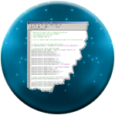
Single message - Receiving
Messaging
Handling message example:
<!-- File: http://remote.com/index.html -->
<body>
<p></p>
<script type="text/javascript">
window.onmessage = function(e){
if( e.origin == 'http://origin.com' )
document.querySelector('p').innerHTML += e.data +'<br>';
};
</script>
</body>

Slide 45
Channels
Messaging
Defines a private channel between two pages
Allows to retrieve a context
Facilitates communication
Managed by a MessageChannel object
Encapsulates two MessagePort objects
Represent current and remote context parts!

Slide 46
Channels
Messaging
To build your channel you need to:
Create a new MessageChannel object
Send a message to your iFrame like we just saw
This time we send the second MessagePort object
This done, you can use your MessagePort objects on each side easily

Slide 47
<!-- File: http://origin.com/channel.html -->
<body>
<button disabled>Send</button>
<iframe src="http://remote.com"></iframe>
<p></p>
<script type="text/javascript">
var button = document.querySelector("button")
, frame = document.querySelector("iframe")
, i = 0
, channel = new MessageChannel()
, p = document.querySelector("p");
frame.onload = function() {
button.removeAttribute("disabled");
frame.contentWindow.postMessage("__SETUP__",
frame.src, [channel.port2]);
};
...
Channels - Example

Slide 48
...
button.onclick = function() {
channel.port1.postMessage(++i);
};
channel.port1.onmessage = function(e) {
if(e.data.__SETUP__)
d.innerHTML += e.data.__SETUP__ + "<br/>";
else if(e.data.number) {
i = parseInt(e.data.number);
d.innerHTML += i + "<br/>";
}
};
</script>
</body>
Channels - Example

Slide 49
Channels
Messaging
We just sent the property port2 on the remote file
It’s the third argument of window.postMessage()
All items passed this way are transferred on the other side
No longer available on your main script

Slide 50
Channels
Messaging
Look at the MessagePort.postMessage() function:
No need to send origin anymore
Just specify data you want to send

Slide 51
<!-- File: http://remote.com/channel.html -->
<body>
<p></p>
<script type="text/javascript">
var p = document.querySelector("p");
window.onmessage = function (e) {
if( e.origin == 'http://origin.com' ) {
if (e.data == "__SETUP__") {
port = e.ports[0];
port.onmessage = onMessage;
port.postMessage({
__SETUP__: "Connection established"
});
} else {
alert("Bad request");
}
}
...
Channels - Receiving

Slide 52
...
else {
alert("Bad origin");
}
}
var onMessage = function(e) {
port.postMessage({
number: parseInt(e.data) + 1;
});
p.innerHTML += e.data + "<br/>";
}
</script>
</body>
Channels - Receiving

Slide 53
Questions ?

Slide 54


